Slide 1


Biocode Commons Identifiers (BCIDS)
A free* for use, persistent identifier solution for biological sample collection from the field, scalable to the billions
*updates & element resolution requires EZID account
BiSciCol

Slide 2

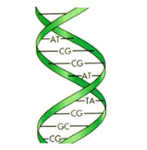
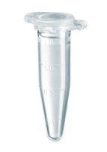
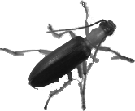

Linking Samples and Derivatives: An example from the Moorea Biocode Project
Taxon
(Taxon)
Taxon*n
Taxon
Key
(Key)
Blast*n
Blast
(Biocode Event)
(metagenomic
Sequencing)
(Gut Sample Event)
(Essig Museum Specimen)
(Genbank Sequence)
(Smithsonian Tissue)

Slide 3
Intersection of Standards & Identifiers
ID
ID
Location / geo-ref
environment
ID
ID
ID
taxonomy
MIxS
investigation
Darwin Core
Material
Sample
Measurement
Nucleic acid sequnece
ID
ID
OBI
ID
analysis
protocols
ID
material
ID
NOTE: Material Sample is a proposed
term for both DwC and MIxS

Slide 4
Information Flow
Current Case
taxon,
Workflow,
2nd copy field-data
who, what, when
(field-data)
Identification, taxon
+ copy of field-data
3rd copy field-data
Field DB
Specimen DB
Lab DB
Repository DB1
Repository DB2
SampleID
SpecimenID
TissueID
RepositoryID1
RepositoryID2
Proposed Case
Who, what, when
Identification, taxon
Workflow
Field DB
Specimen DB
Lab DB
Repository DB1
Repository DB2
ark:/21547/b2_{LocalID}
a obi:MaterialSample;

Slide 5
Anatomy of a BCID
ark:
/21547
/b2
_{LocalID}
EZID /
Group
Identifier
ark: = scheme
21547 = Name assigning authority
b2 = Shoulder / Group Identifier (Contains a common concept which
all child elements share)
Defines a grouping of conceptually similar objects or processes: E.g. Sample,
Collecting event, Image. This portion registered with EZID for all Data Groups through
the BCID EZID Account free of charge.
BCID /
Element
Identifier
LocalID = Local ID, Darwin Core Triple, or UUID
Defines an element contained with a group, available via the BCID resolver or
registerable via EZID (requires an individual subscription to EZID)

Slide 6
BCIDs
Extends EZIDs (from California Digital Library), based on ARK/DOI technology.
Easy to pre-generate identifiers for field sampling and resolve them later
BCIDs are API driven, but have a User Interface
Open on a limited basis to projects wishing to help test
See http://code.google.com/p/bcid/ for more information.

